Slide 1

Day 2, part 3 – optimization spark performance
ITG DATAHUB ST
Paris, September 24th, 2019

Slide 2
Agenda
1
Introduction TO SPARK
Context
Spark Architecture
RDD (Resilient Distributed Datasets)
2
Spark otpimization
Partitions and Partitioning
Repartitioning
Spark Pre-Configurations
Demonstration

Slide 3

Introduction to spark
1

Slide 4
Context
Processing large volumes of data
Distributed processing
Framework open source coding in Scala

Slide 5
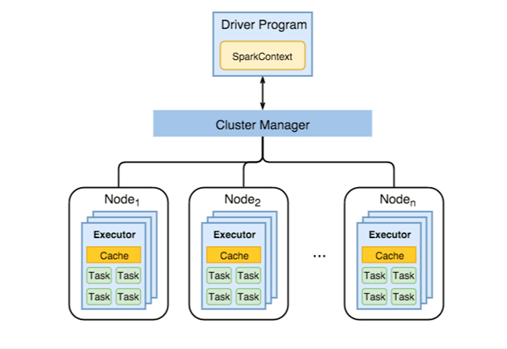
Spark Architecture
Driver
Talks to a single coordinator called Cluster Manager
Coordinates workers and overall execution of tasks
Get the results of executors
Cluster Manager
In our case it’s Hadoop YARN (Yet Another Resource Negotiator)
Executors
Distributed agent that is responsible for executing tasks

Slide 6
RDD (Resilient Distributed Dataset)
It is an immutable distributed collection of object
Each dataset in RDD is divided into logical partitions
Which may be computed on different nodes of the cluster
RDDs can be created only through deterministic operations
Either from data stored in a stable storage
Either from other RDDs

Slide 7
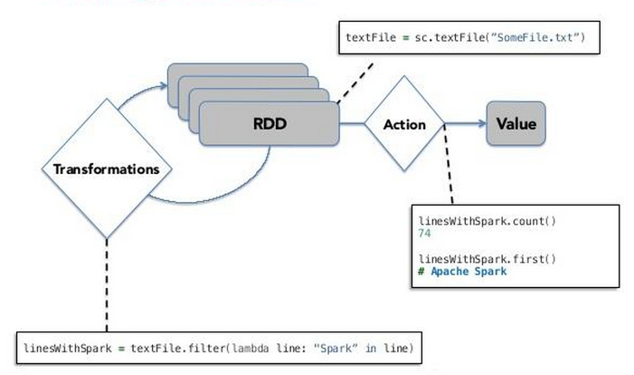
RDD (Resilient Distributed Dataset)
Transformation
Map, filter, join functions…
Action
Count, collect save functions…

Slide 8
Spark optimization
2

Slide 9

Partitions and Partitioning
Not enough partitions
x2

Slide 10
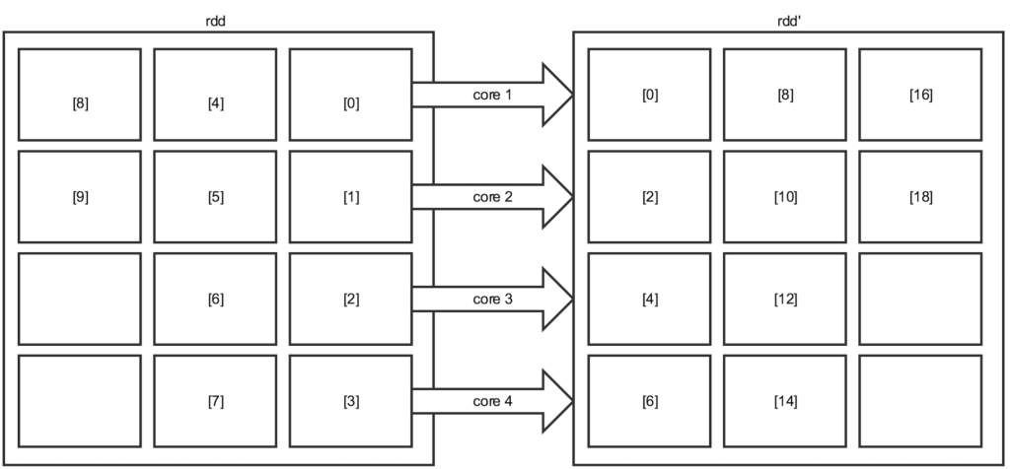
Partitions and Partitioning
Too much partitions
x2

Slide 11
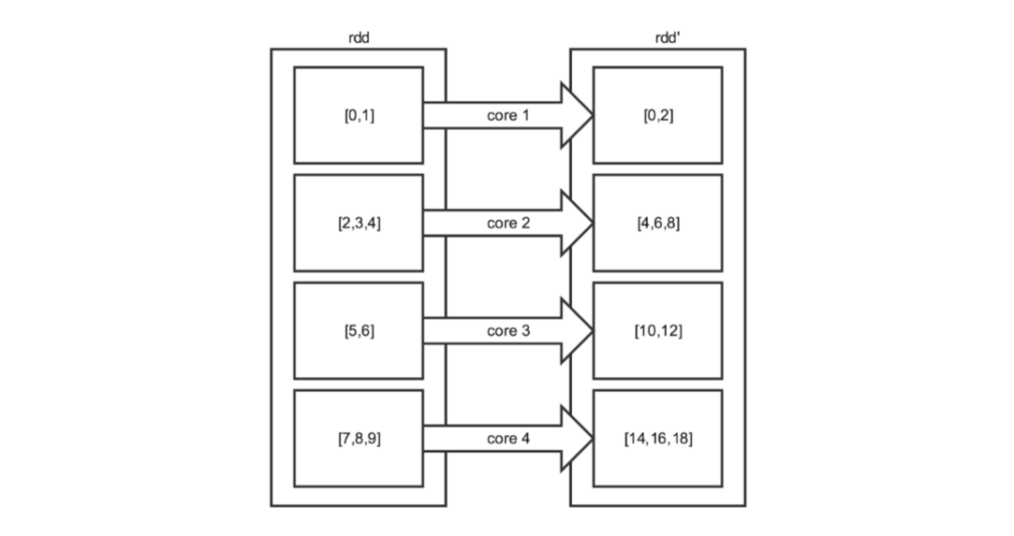
Partitions and Partitioning
The good one
x2

Slide 12
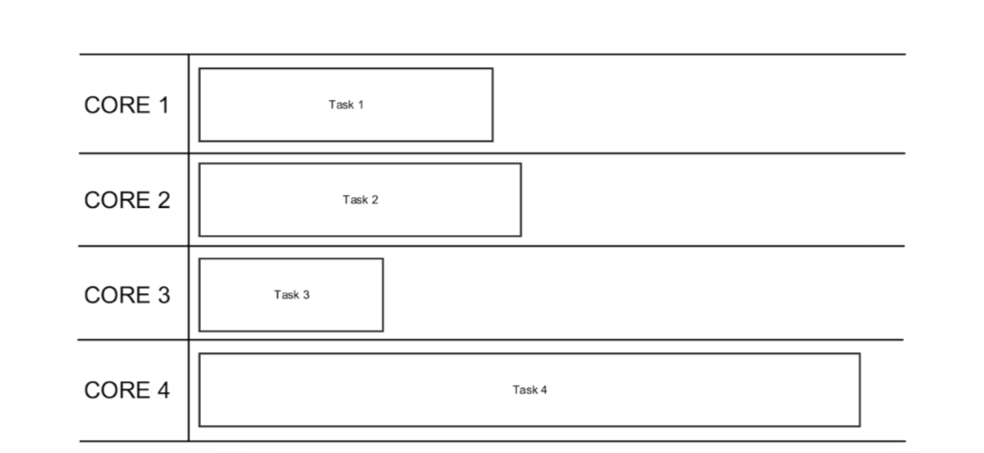
Partitions and Partitioning
Time execution due to
Size of partition
Cores slower than other

Slide 13
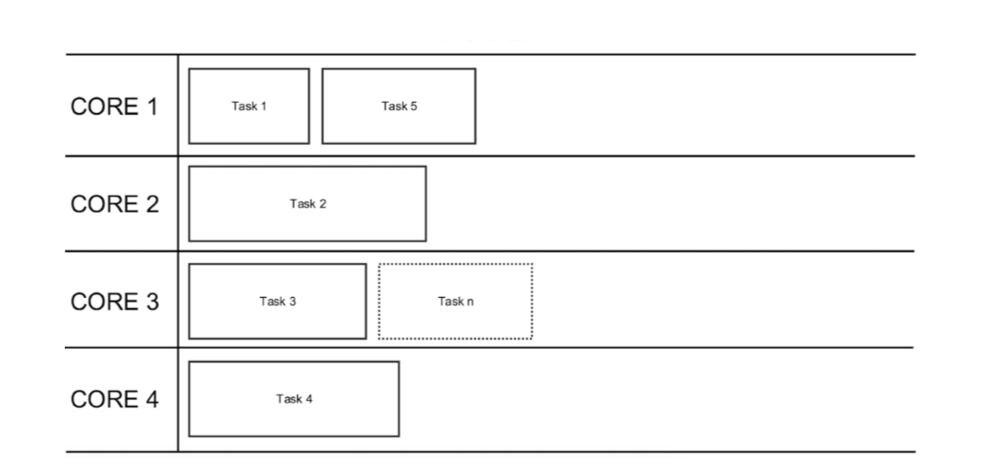
Partitions and Partitioning

Slide 14
Partitions and Partitioning
Spark Recommendation: 3 to 4 times more partitions that core allocated

Slide 15
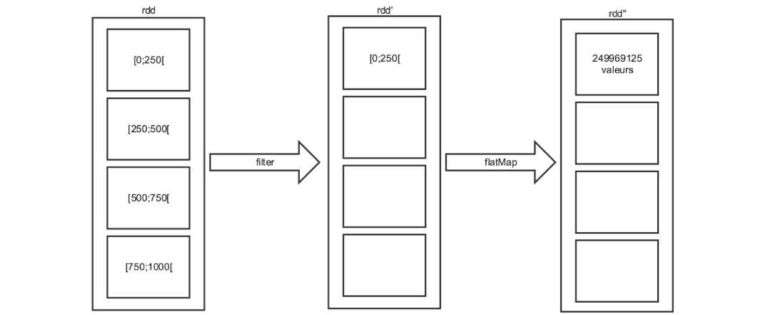
Repartitioning
Issue Data Skewing:

Slide 16
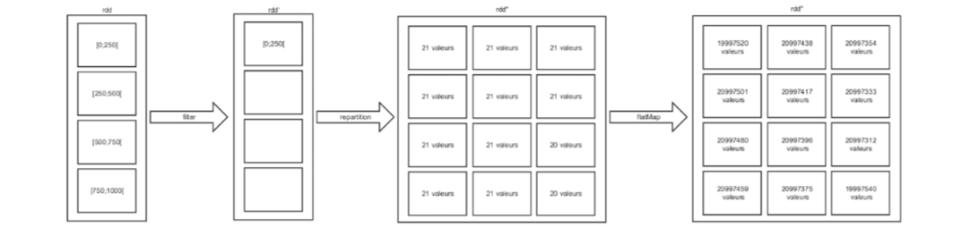
Repartitioning
Solution Data Skewing:

Slide 17
Spark Pre-Configurations
spark.executor.cores:
number of core per executor
spark.executor.memory:
allocation memory per executor
spark.executor.instances:
number of executor
spark.driver.memory
allocation memory of driver

Slide 18
Spark Pre-Configurations
Default
spark.executor.cores = 5
spark.executor.memory = 6g
spark.executor.instances = 3
spark.driver.memory = 3g
15 cores, 45-60 partitions, datasets>500mb
Yarn-large
spark.executor.cores = 5
spark.executor.memory = 16g
spark.executor.instances = 25
spark.driver.memory = 8g
50 cores, 150-200 partitions, 500mb<datasets<5gb
Yarn-medium
spark.executor.cores = 5
spark.executor.memory = 10g
spark.executor.instances = 10
spark.driver.memory = 5g
125 cores, 375-500 partitions, datasets>5gb

Slide 19
DEMONSTRATION

